Slide 1
Data Analytics using Python (Edunet)
By: Tanmayee Inaganti
AP22110011499

Slide 2
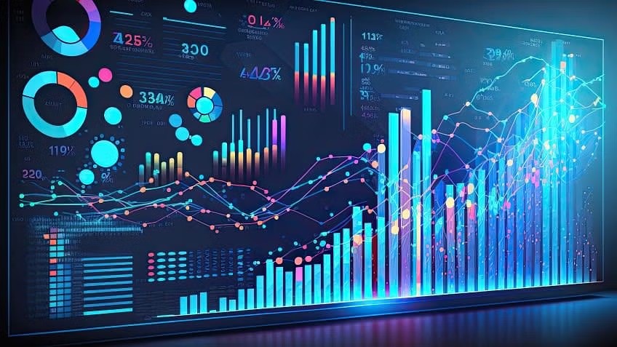
What is Data Analytics
Data Analytics is the process of examining data sets in order to draw conclusions about the information it contains
Different types:
Descriptive
Diagnostic
Predictive
Prescriptive

Slide 3

What is a Data Analyst?
Data Analysts examine large datasets with the goal of identifying trends and patterns. Once this is done, they visualize the findings in graphs, charts and more.
Tools: Python, R, Tableau, Power BI, SAS

Slide 4
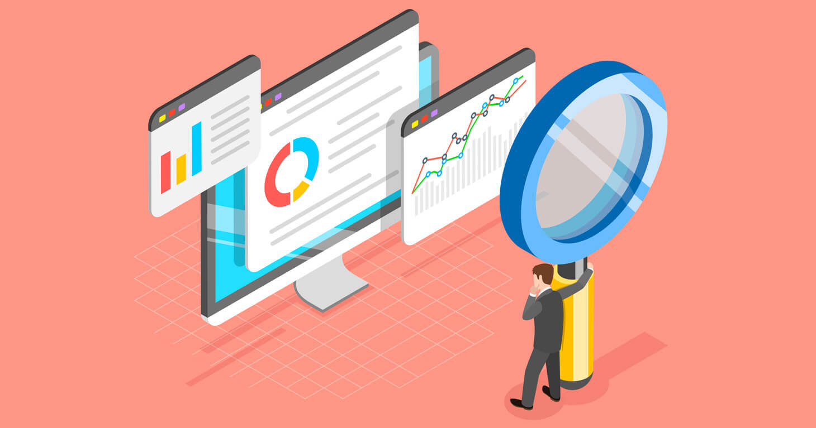
Steps for analyzing data
Define your goal for the data
Collect the data
Clean the data
Analyze the data
Visualize the data

Slide 5

Pandas in Python
Pandas is an open-source library used for data manipulation and analysis.
It is used to clean up data, handle missing data, visualize data, and for an optimized performance
Functions:
df.head(): displays first 5 rows
df.tail(): displays last 5 rows
df.info(): gives more information about the dataframe

Slide 6
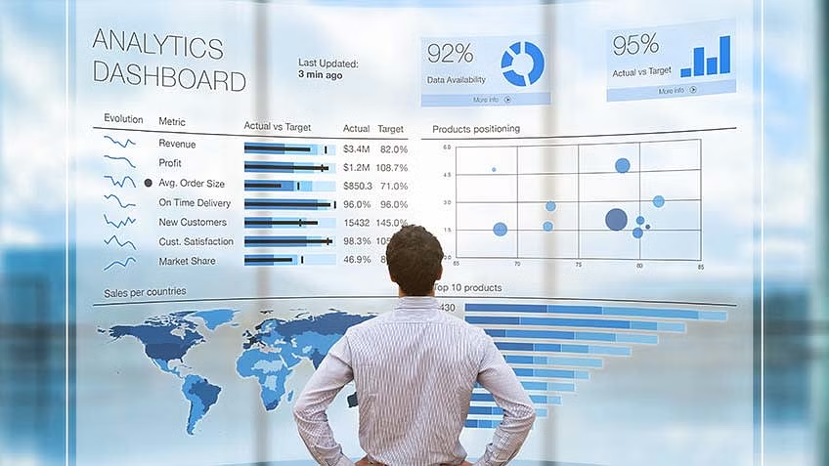
Overall use of Data Analytics
Data Analytics helps people to understand the data and to make better decisions
DA is important for business:
Gain greater insight into target markets
Enhance decision making capabilities
Create targeted strategies and marketing campaigns

